Slide 1

BB84 Protocol Quantum Key Distribution
Realized by:
Mohamed Amine Garrach
Supervisor
Mrs. Manel Boujelben
Examiner
Mr. Faouzi Zarai

Slide 2
q
Content
1
2
3
Introduction
Quantum Cryptography
overview
BB84 Steps
4
5
6
Eve’s Attacks
BB84 Implementation
(Demonstrative Video)
Conclusion &
Perspectives

Slide 3
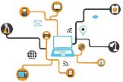




Introduction
1
Nowadays:
Devices will be more connected
Increase digitization
Personal data at risk
Key distribution:
Classical key distribution not well secure.
Based on physics and Quantum mechanics concepts, Quantum key distribution more secure.

Slide 4



1
Problem
Problem
During key generation, another unauthorized entity may copy or sniff the key.
Weak computation
Failure of authentication

Slide 5
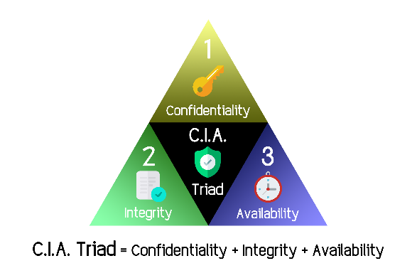
1
Goal
Alice and Bob want to establish a secret key for subsequent communication via Classical Channel
A secure Communication
Have access to a Quantum Channel (conserves Qubit states)
Use a classical communication channel (public channel, e.g. internet)

Slide 6
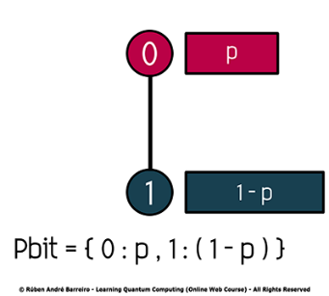
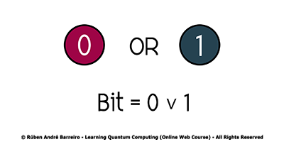
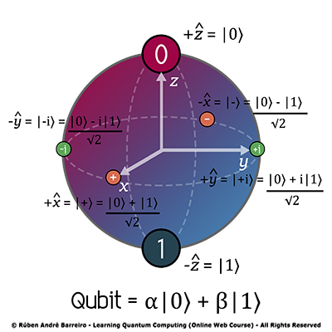
Quantum Cryptography Overview
2
Quantum bit & Classical bit :
A qubit can take infinitely many different values.
The quantum bit (or qubit) can be found in a superposition of both states 0 and 1.
Essentially it can be 0 and 1 at the same time until a measurement is made.

Slide 7


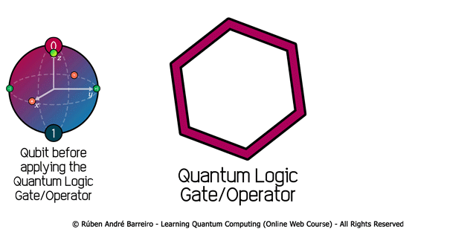

2
measurement (Schrödinger's cut):
Quantum Gates :
Superposition :

Slide 8



BB84 Quantum Key Distribution Protocol steps.
3
Alice
QKD system ready
Bob
1
2
Generated random bits,
random encoding bases
random decoding bases
3
Wait for Quantum state
4
5
Prepare and send data in Quantum state
Measuring
6
Public Discussion started(Classical channel)
7
8
Send random Bases
Send random Bases
9
Final Quantum shared key

Slide 9
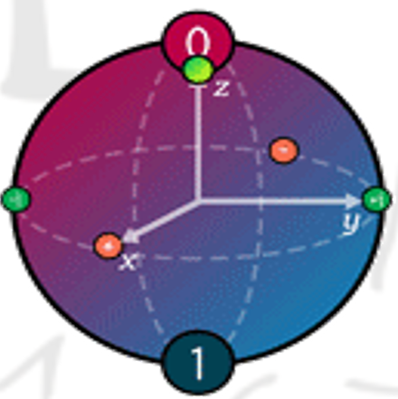


Eve’s Attacks
4
Quantum channel
Classical channel
Examples of attacks:
Intercept-Resend strategy.
Photon Number Splitting Attack.
Intermediate basis method.

Slide 10
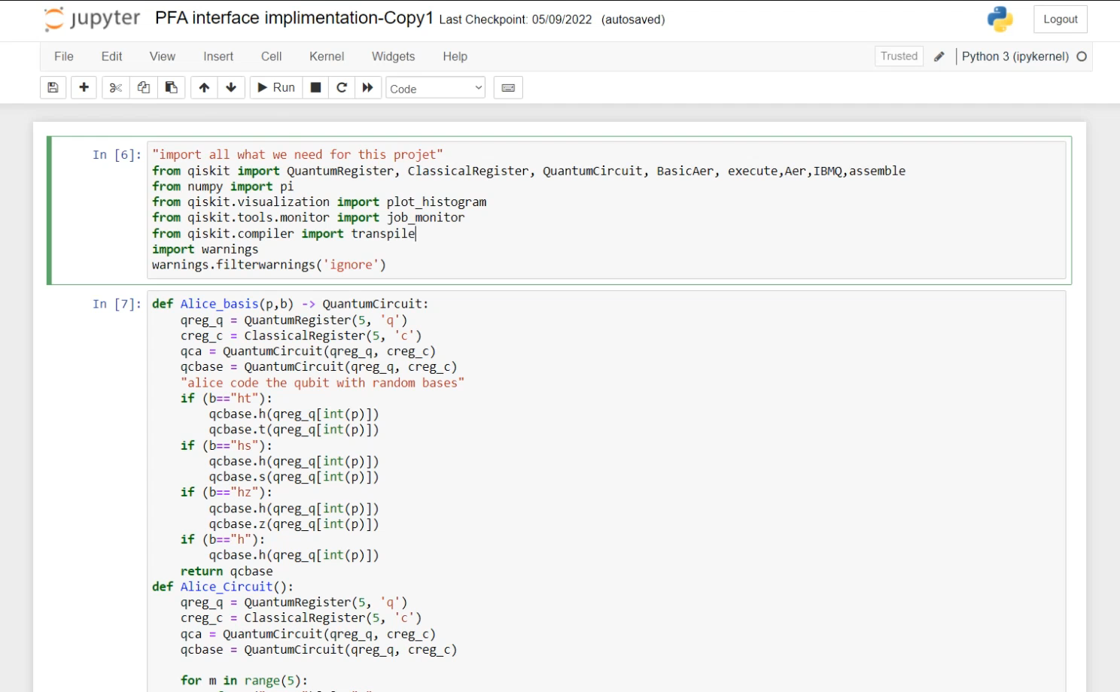
5
BB84 Implementation (Demonstrative video)
Link

Slide 11

Conclusion
6
Design and develop a user interface for the BB84 protocol
Solve problems by offering Quantum Computing Devices.
The use of BB84 protocol:
Security and trust
Reduced human errors

Slide 12
Perspectives
Possible work improvements :
Use the final key generated in real communication devices and compare it with a classical security protocol.
Implement another QKD protocol and compere the outcome result between the two protocols
Other algorithms based on Quantum Cryptography
Post-Quantum key distribution:
Example: GGH (Lattice Cryptography)
NTRU (Truncated Polynomials)
Quantum key distribution:
Example: E91 & BBM92 protocol: entanglement protocol SARG04

Slide 13


